Slide 1

Assessment for Data Science - Sagility
Savita R S

Slide 2
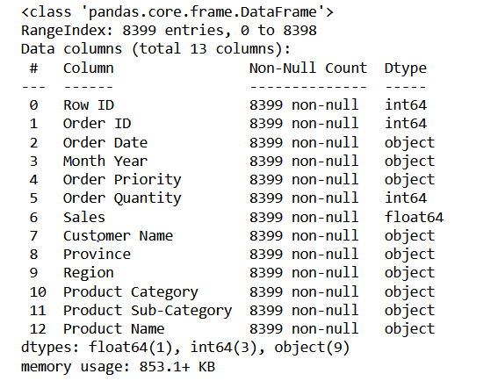
Sample - Superstore Sales
There are total 8399 number of rows and 13 number of columns present.
There are no missing values and all the data types have been identified correctly,

Slide 3
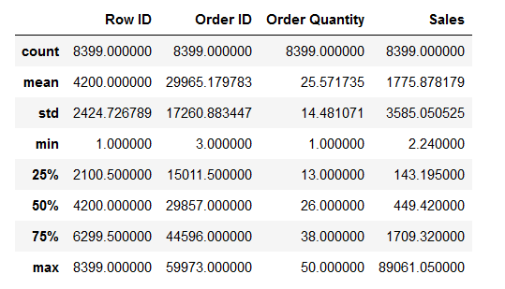
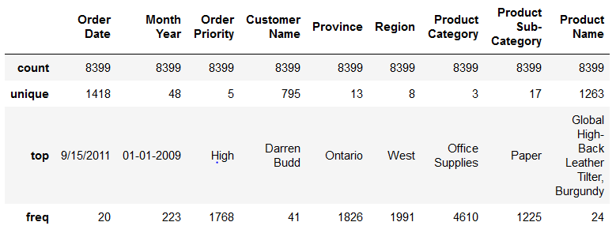
Data description
For numerical variables
The mean of Order quantity is less than Sales.
The std is 14.4810 which is very less than Sales .
For categorical variables
Count of all variables is same , hence no missing values present.
Frequency is more in Province column.

Slide 4
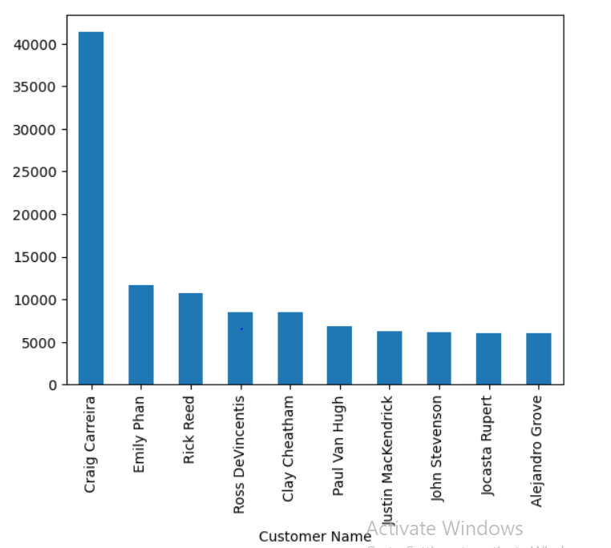
Average sales per Customer
Craig Carreira has highest average sales compared to any other customers

Slide 5
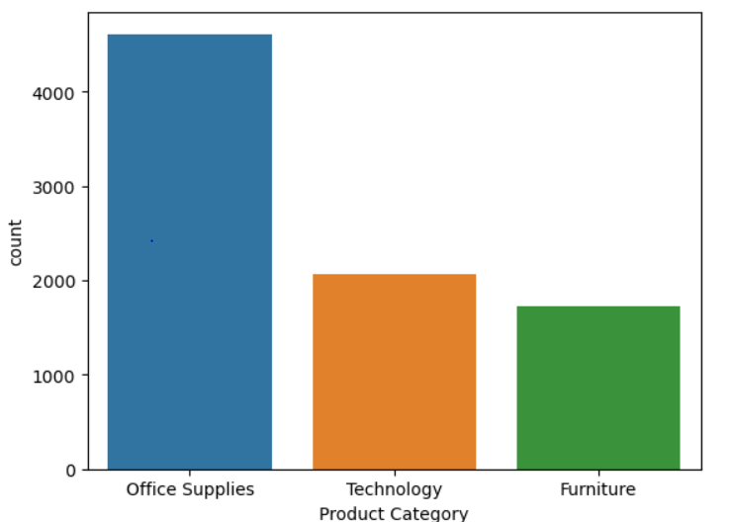
Average transaction size by product category
Assuming that indicating the number transaction that took place for each product category is the office supplies is the product that has done a lot of transactions.

Slide 6
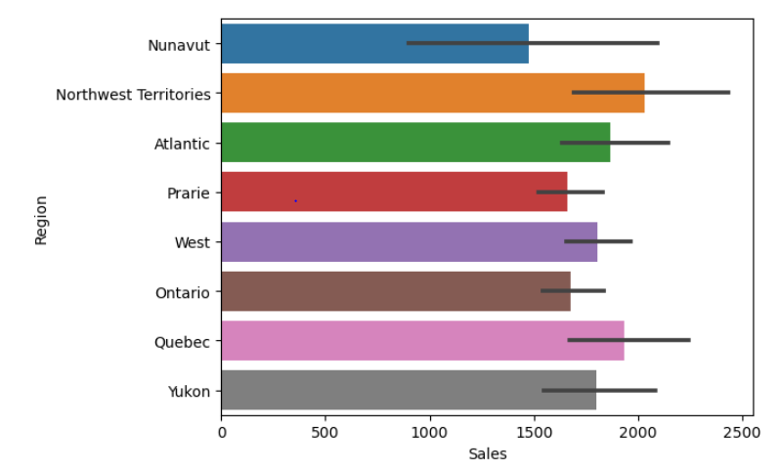
Average sales Region wise
Northwest Territories has slightly highest average sales but key thing to note here is that Nunavut has lowest sales which needs to be looked into.

Slide 7
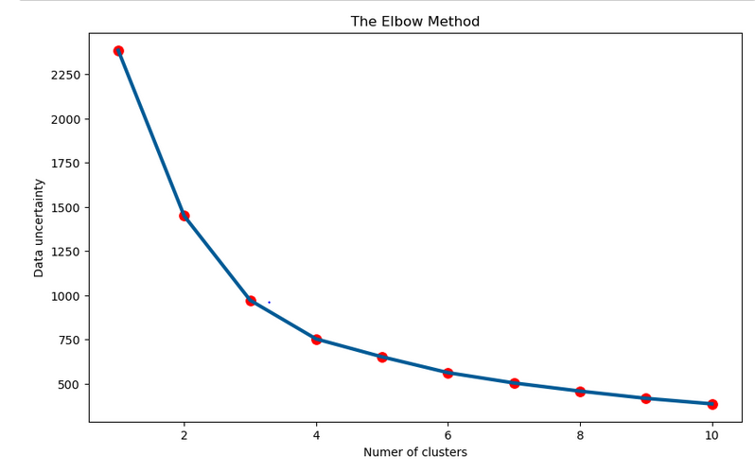
Elbow plot
Elbow plot we can say that 3 or 4 are the optical cluster size. Let's try with silhouette score

Slide 8
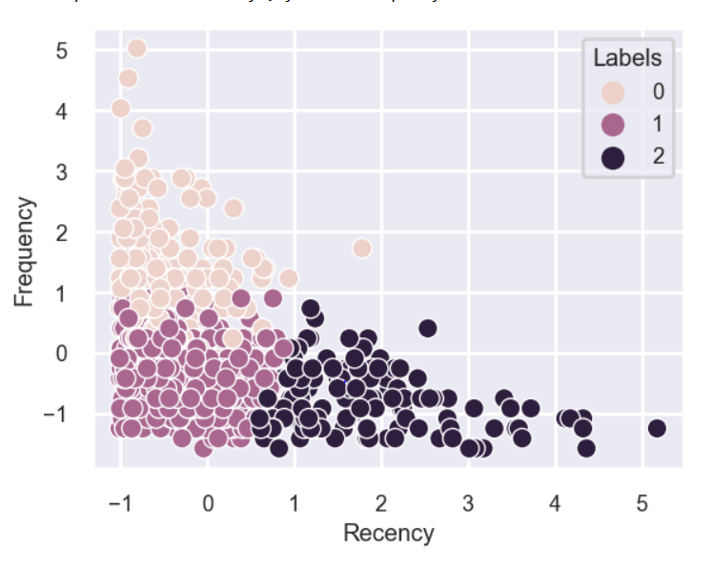
K Means clustering RFM plot
Scatter plot of Frequency and Recency shows the data differentiation using labels 0,1,2

Slide 9
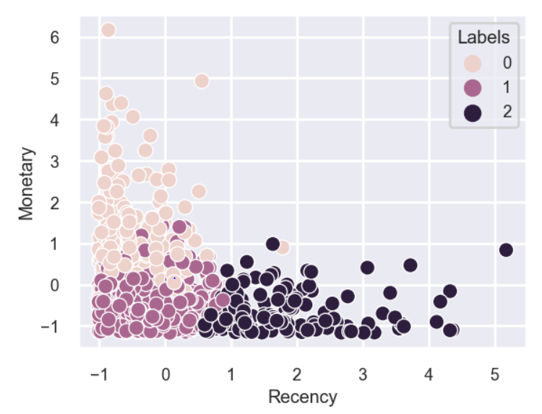
K Means clustering RFM plot
Scatter plot of Monetary and Recency shows the data differentiation using labels 0,1,2

Slide 10
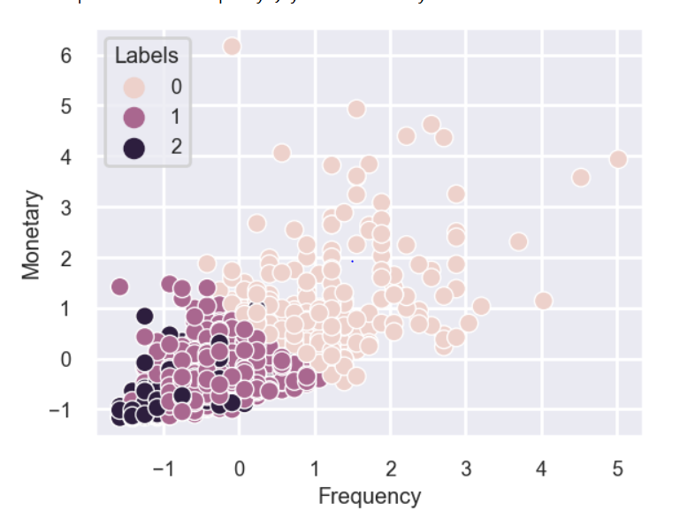
K Means clustering RFM plot
Scatter plot of Monetary and Recency shows the data differentiation using labels 0,1,2

Slide 11
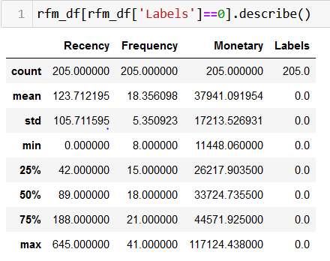
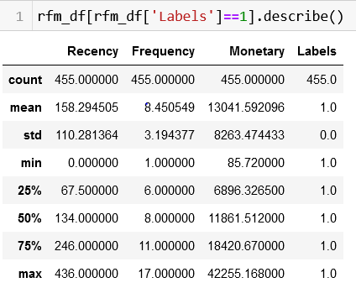
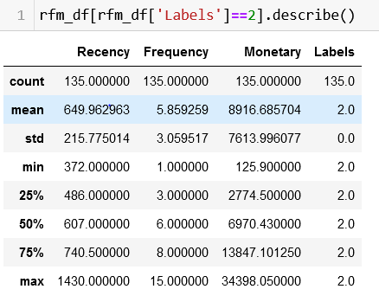
RFM values of the label 0,1,2 from the scatter plots

Slide 12
Conclusion
As we can cluster 0 recency is very low compared to other clusters customers.
We can also see that cluster 0 frequency is high.
We can see that Monetary is very high for cluster 0.
This indicates that customers how belongs to the cluster 0 are the golden customers, because they are frequent in terms of ordering products, they are also very recency in nature, and they spend a lot compared to others.

Slide 13
.
Thank you

